Slide 1
Rootless
Streamlined visa support for travelers worldwide
Group 8

Slide 2
What is Rootless?
A mobile app that turns immigration research into a personalized action plan
Enter your passport, destination, and relocation goal and Rootless handles the rest
Filters and ranks visa options, then builds a step by step checklist with deadlines based on your arrival date
Visa Life Planner sends alerts when life changes like a new job or marriage affect your status
A guided relocation workflow from research to residency, not just a visa lookup tool

Slide 3
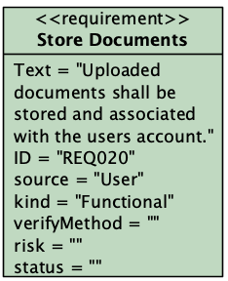
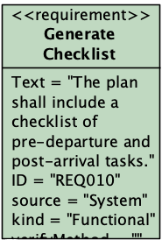
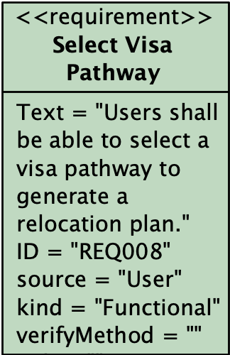
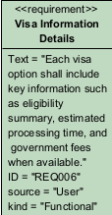
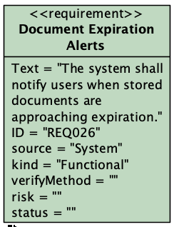
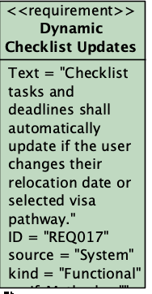
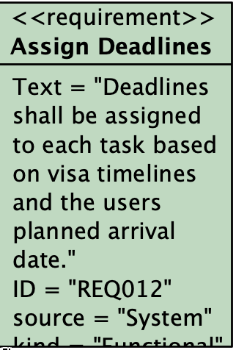
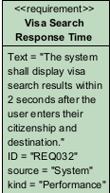
User Requirements

Slide 4
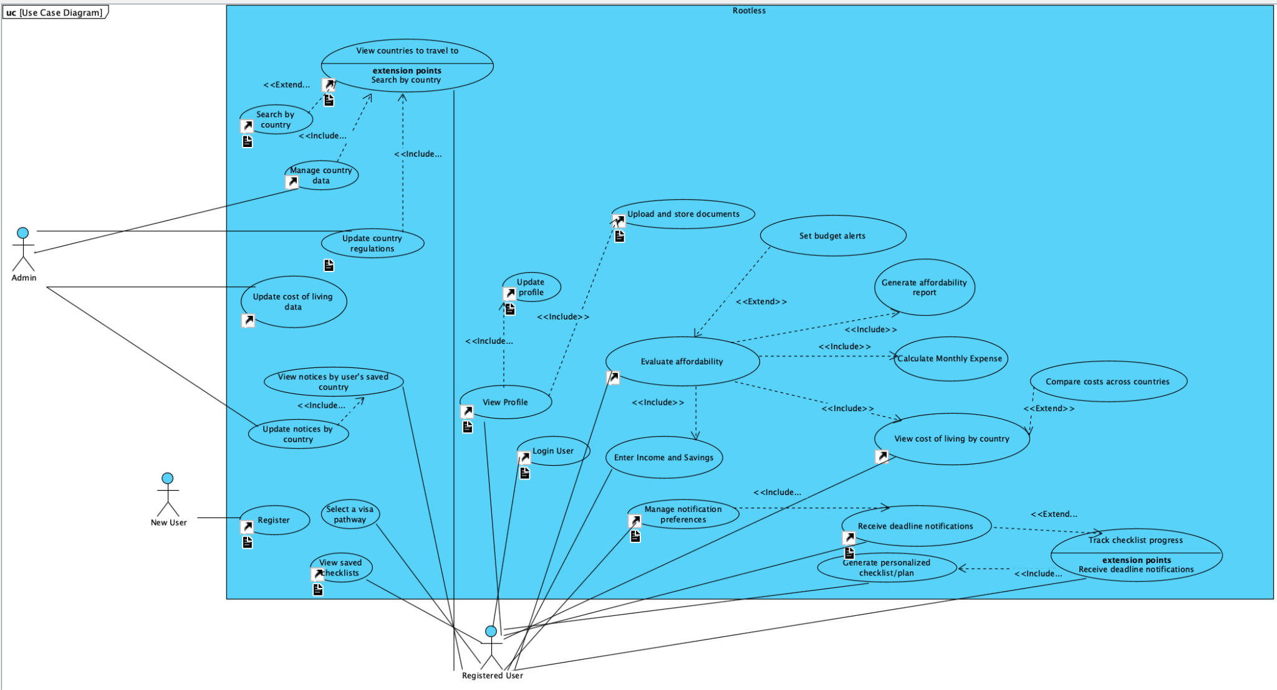
Use Case Diagram

Slide 5
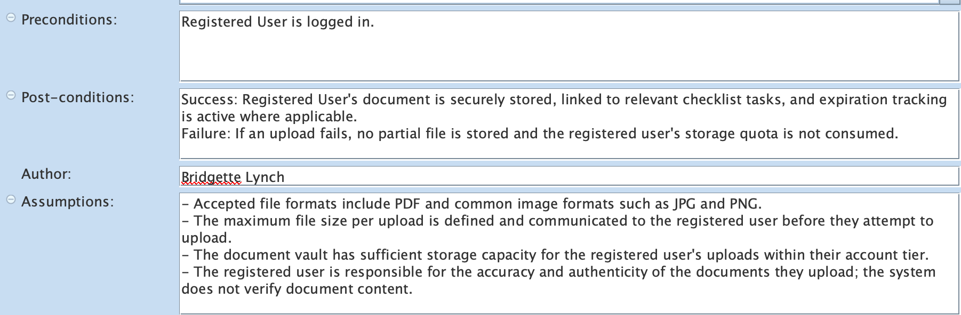
Use Case: Upload and Store Documents
Description: A logged-in Registered User uploads documents to their secure document vault, assigns each a document type, optionally records an expiration date, and links the document to relevant checklist tasks. The system encrypts and stores the file.
Specification Elements:

Slide 6
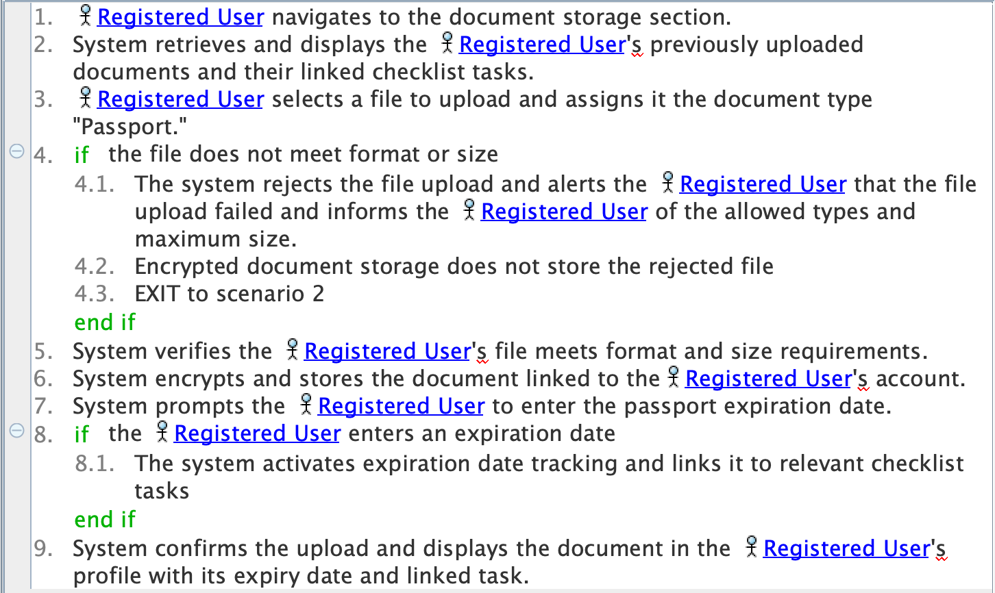
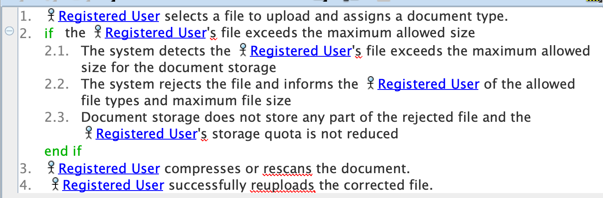
Use Case: Upload and Store Documents
Sunny Day: User uploads passport scan and links to relevant checklist task
Rainy Day: User attempts to upload file of incorrect size

Slide 7
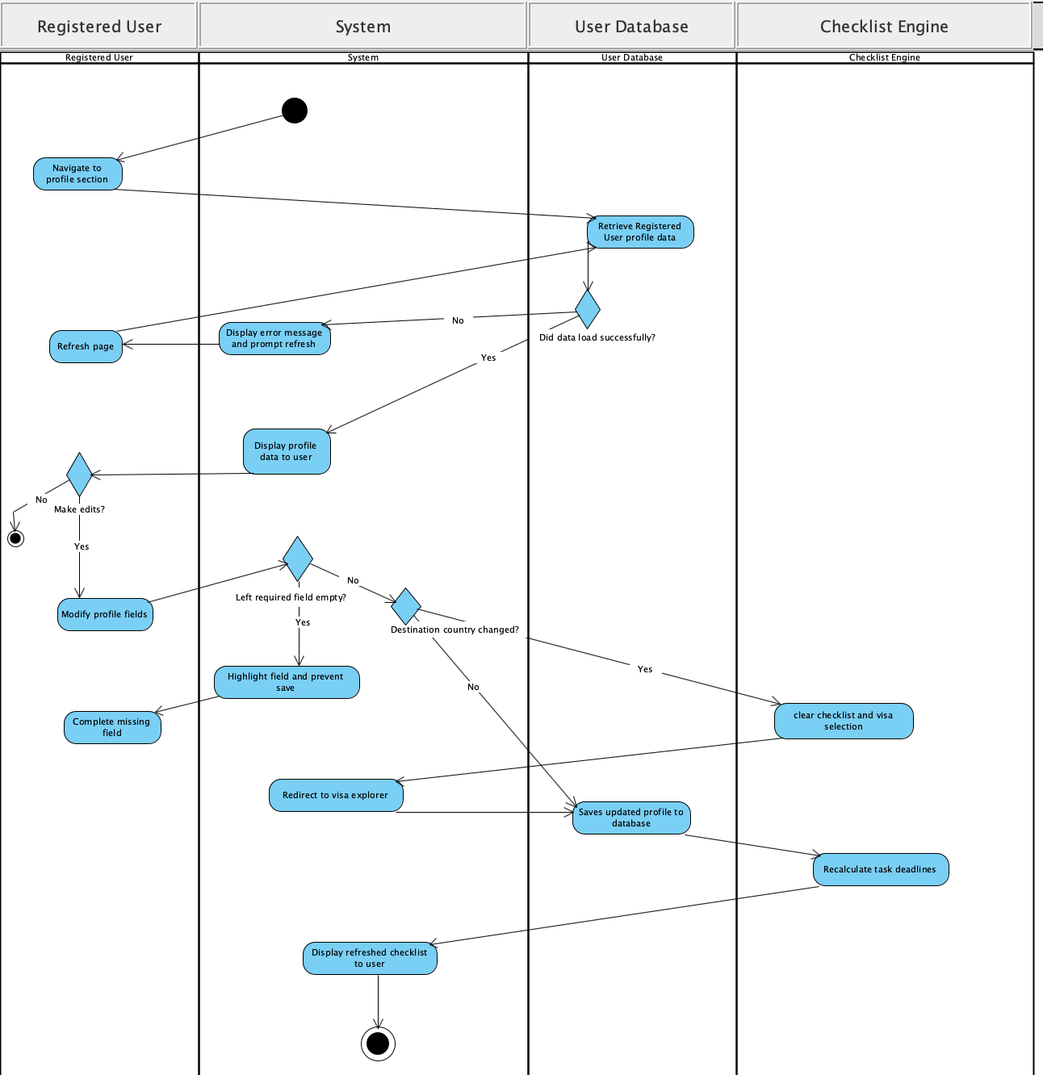
Use Case: Upload and Store Documents
Activity Diagram:

Slide 8
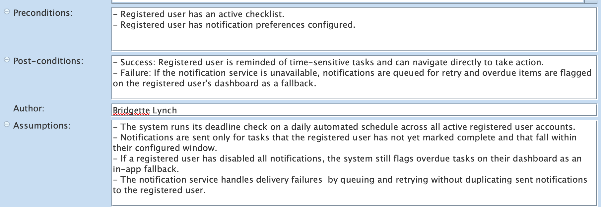
Use Case: Receive Deadline Notifications
Description: The system identifies upcoming task deadlines and expiring documents within each registered user's configured notification window and sends reminders through the method the registered user chose. This use case includes Manage Notification Preferences and extends Track Checklist Progress.
Specification Elements:

Slide 9
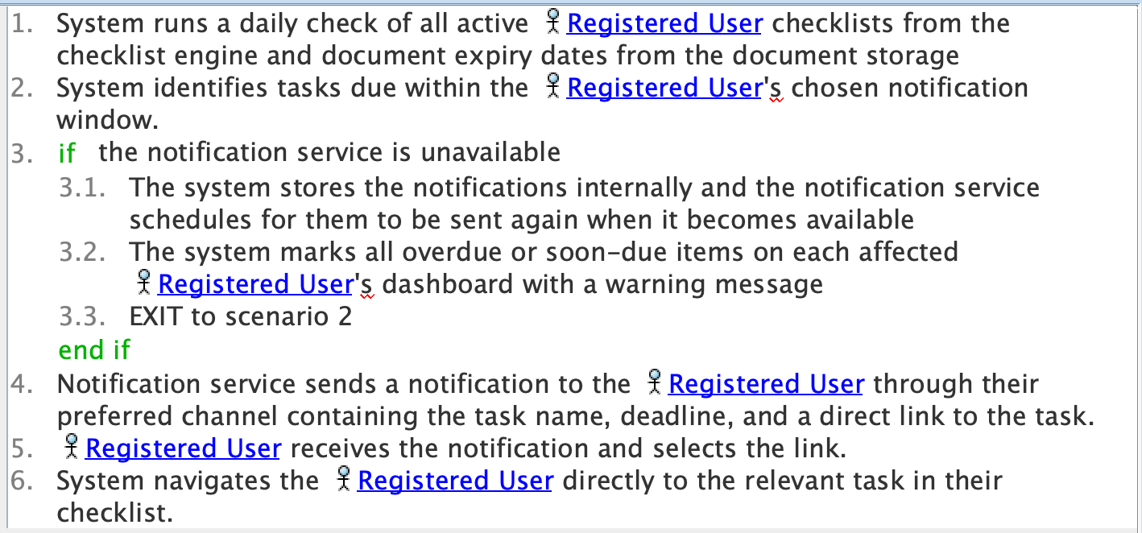
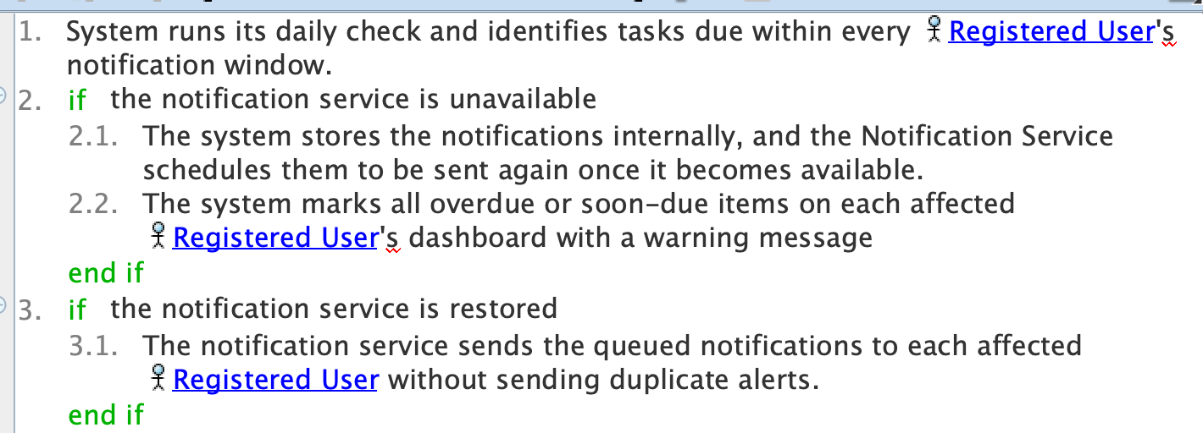
Use Case: Receive Deadline Notifications
Sunny Day: System sends deadline reminder to user.
Rainy Day: Notification service is unavailable when reminder should be sent.

Slide 10
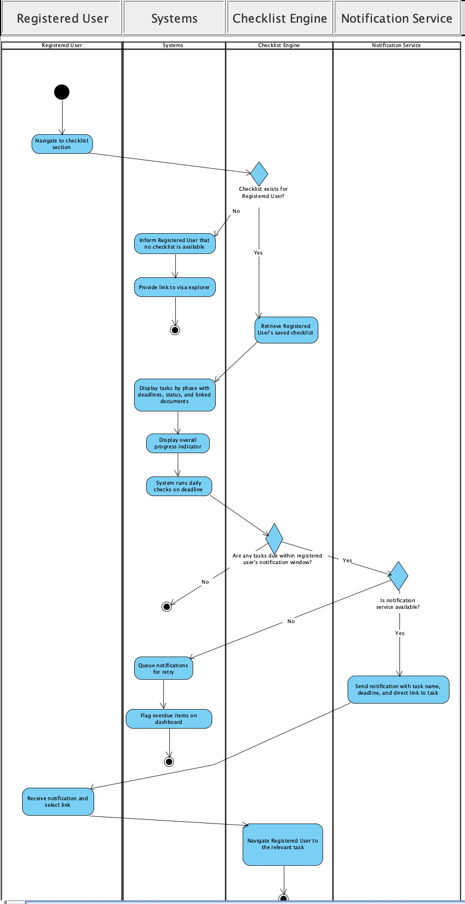
Use Case: Upload and Store Documents
Activity Diagram:

Slide 11
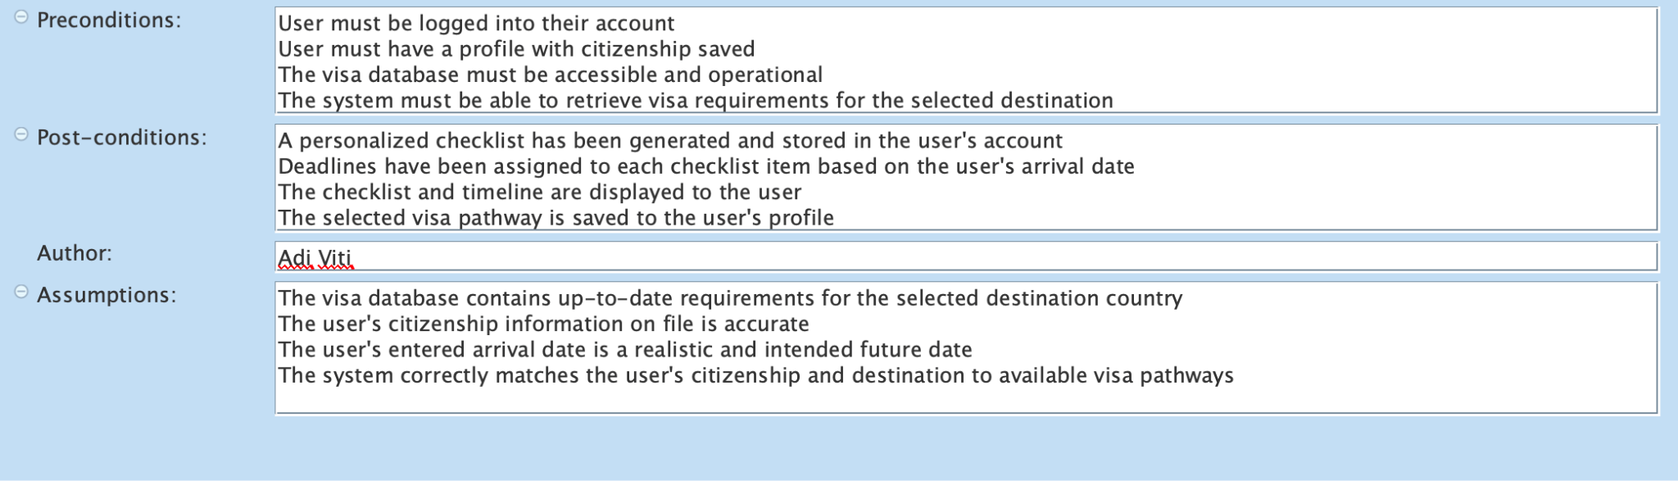
Use CASE: Generate personalized plan FOR SELECTED COUNTRY & VISA

Slide 12
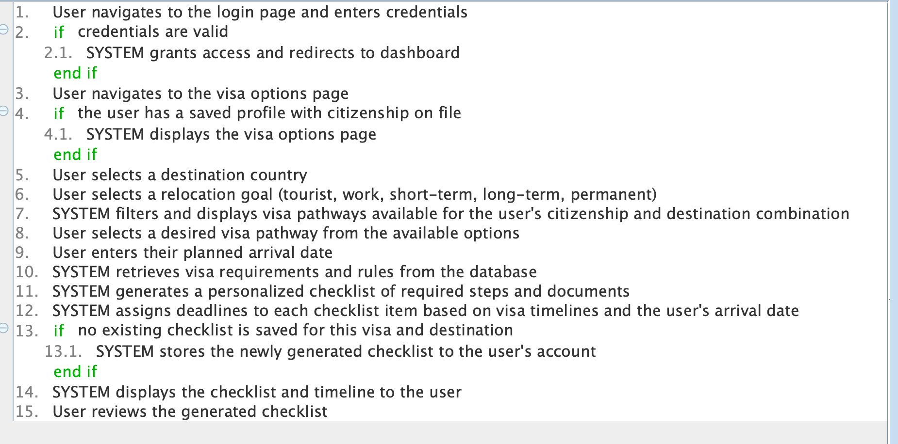
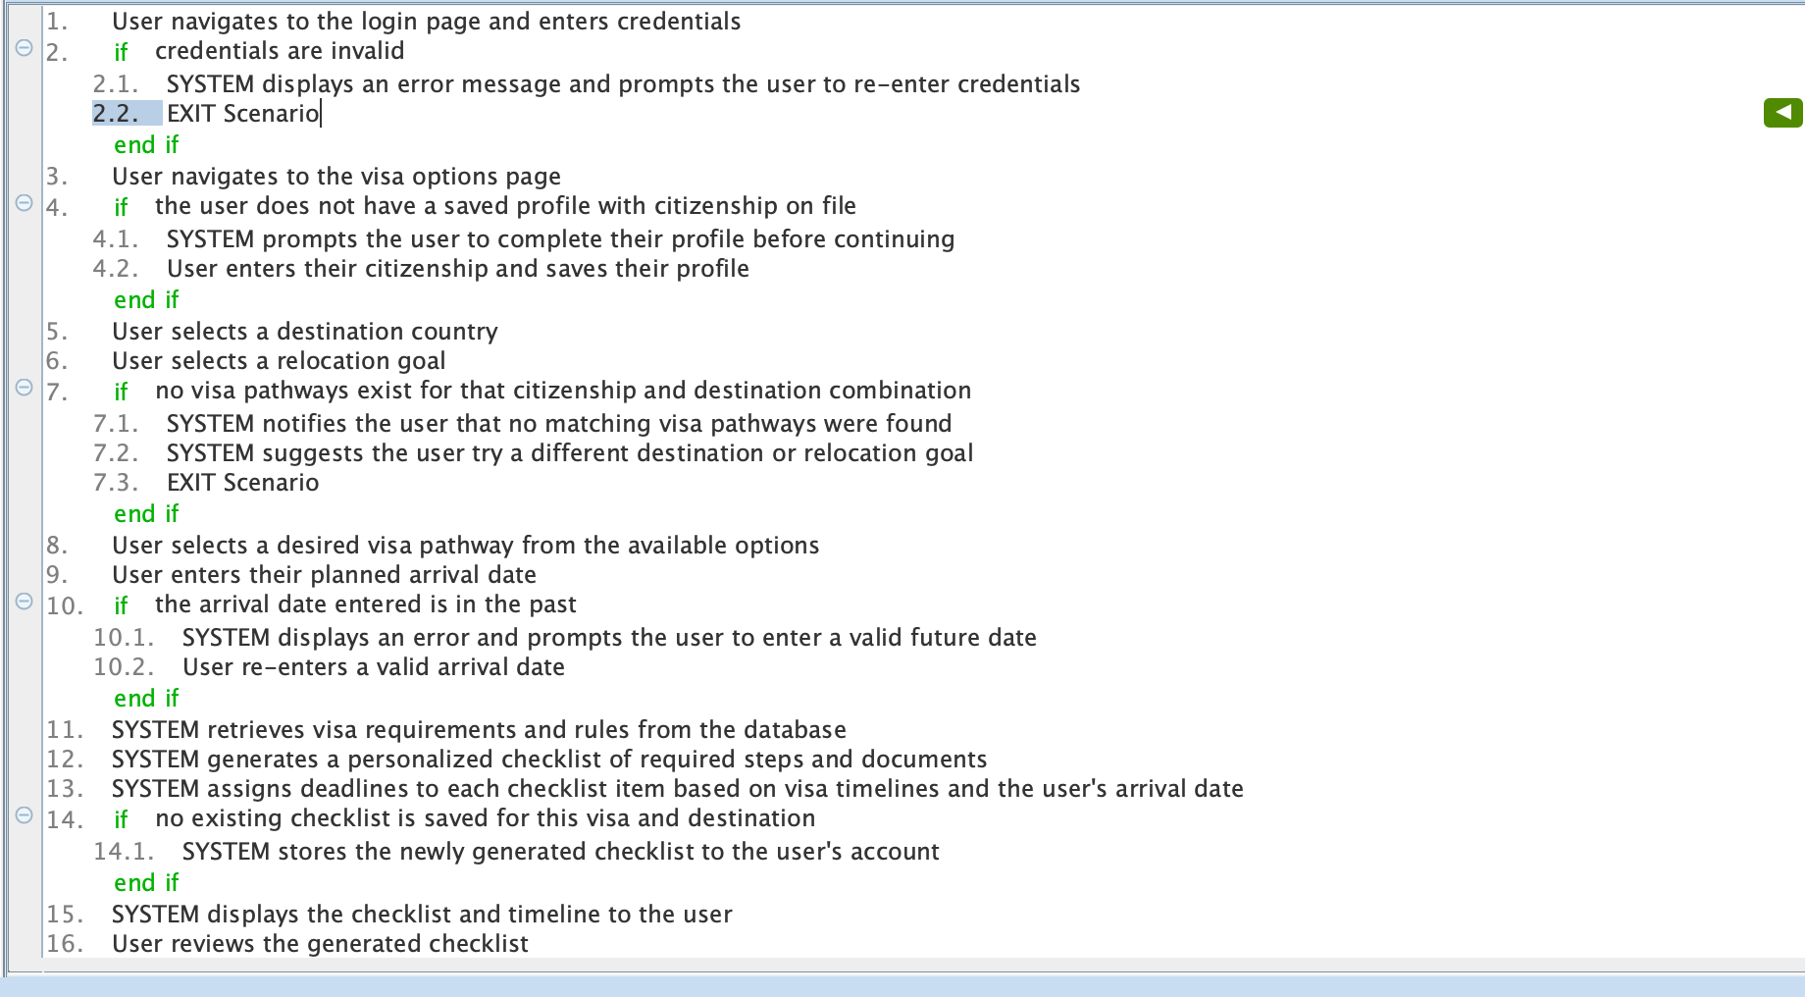
Use CASE: Generate personalized plan FOR SELECTED COUNTRY & VISA
Sunny Day
Rainy Day

Slide 13
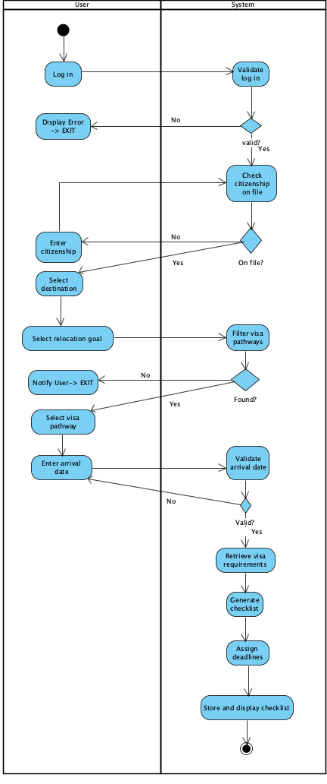
Use CASE: Generate personalized plan FOR SELECTED COUNTRY & VISA
Activity Diagram:

Slide 14
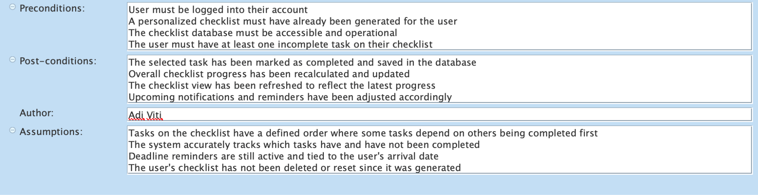
Use CASE: Track checklist progress

Slide 15
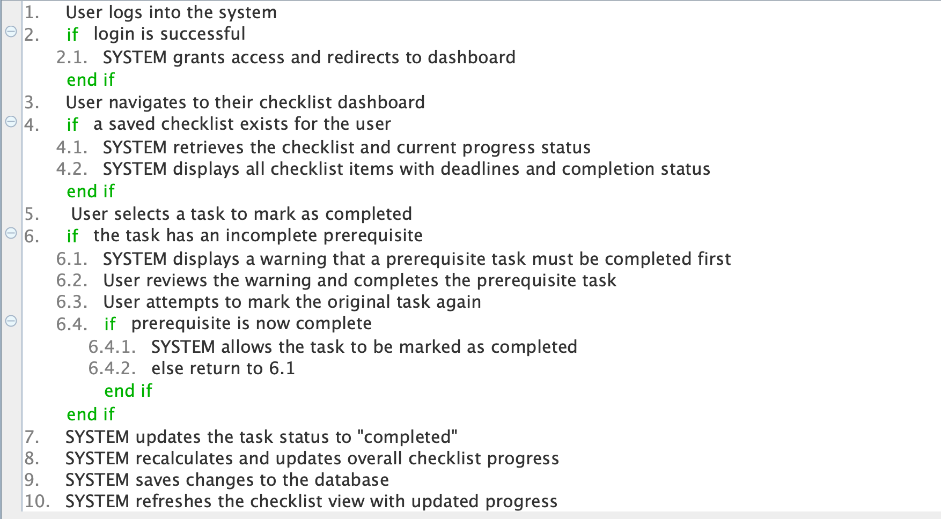
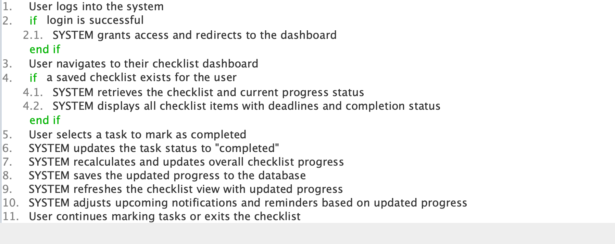
Use CASE: Track checklist progress
Sunny Day
Rainy Day

Slide 16
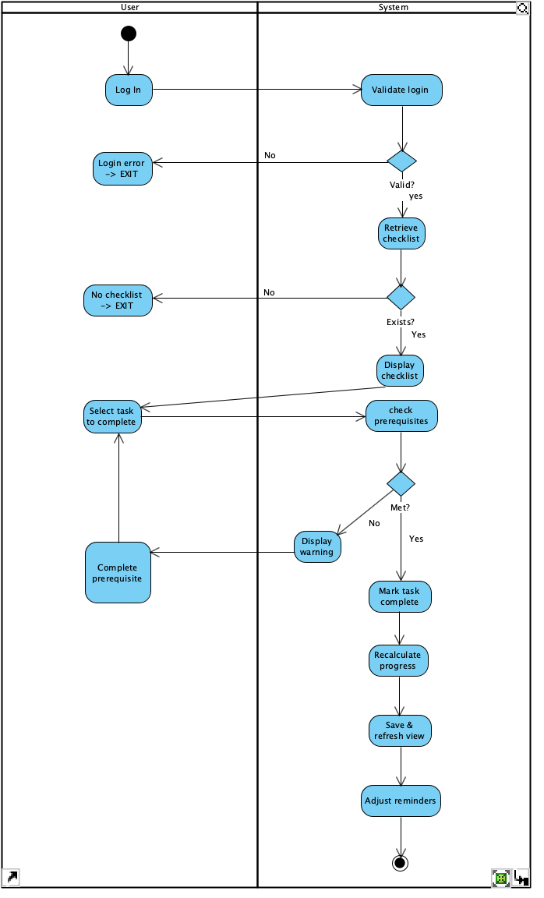
Use CASE: Track checklist progress
Activity Diagram:

Slide 17
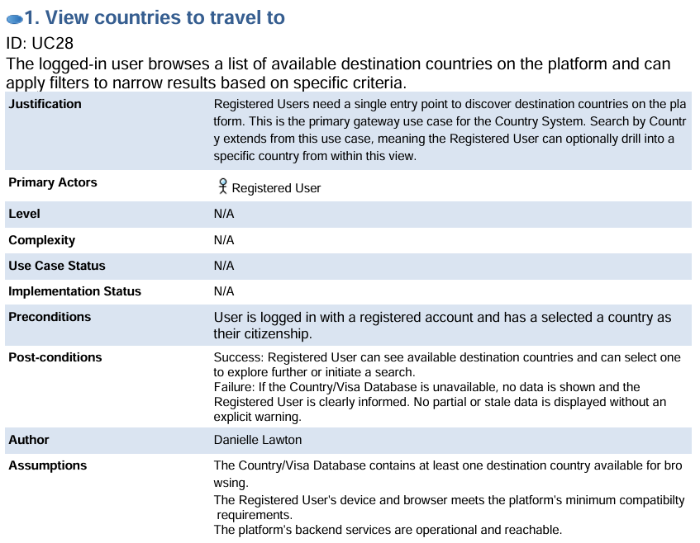
View Countries to Travel to
Notes:
This is the primary entry point into the Country System and serves as the gateway through which registered users begin exploring destination countries on the platform.
The primary actor is the Registered User One important design decision worth noting here is that we require users to create an account before accessing any content. This means browsing countries is gated behind registration, which ensures every experience on Rootless is personalized from the start.
For this use case to begin, the registered user must be logged in with a verified account. We also assume that the Country and Visa Database has at least one destination available, that the platform's backend services are operational, and that the user's device meets our minimum compatibility requirements.
On success, the registered user can see available destinations and select one to explore further. On failure, the user is clearly informed that data is unavailable and no misleading information is presented.

Slide 18
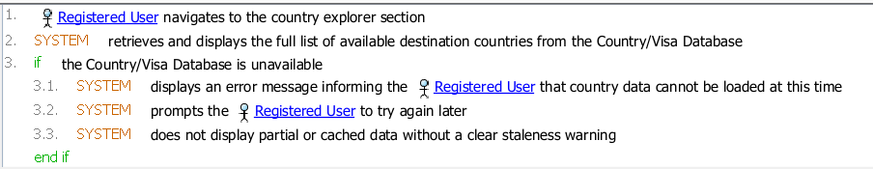
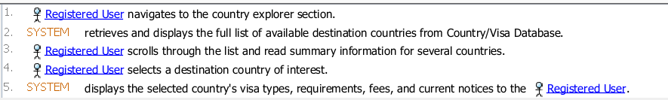
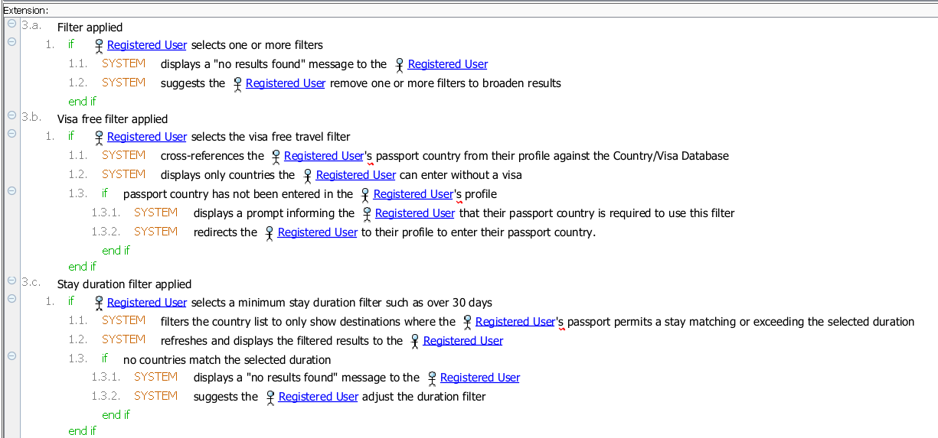
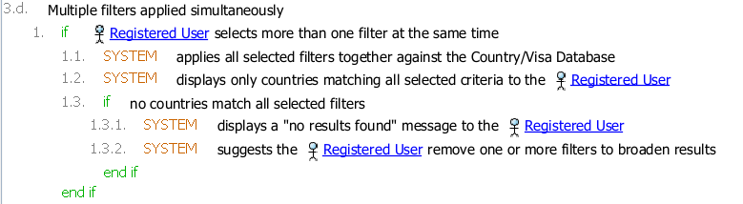
View Countries to Travel to
Sunny Day- Registered User successfully browses the full country list and selects a destination.
Rainy Day- Country/Visa Database is unavailable when the Registered User tries to browse.
Notes:
Once on the country explorer page, the registered user can browse the full list of destination countries. From this view they can apply filters to narrow results — for example filtering by visa-free travel, which cross-references their passport country against the database, or filtering by minimum length of stay such as over 30 days. Multiple filters can be applied at the same time and results refresh in real time. Search by country name, another use case also extends from this use case since searching happens within the browsing context.

Slide 19
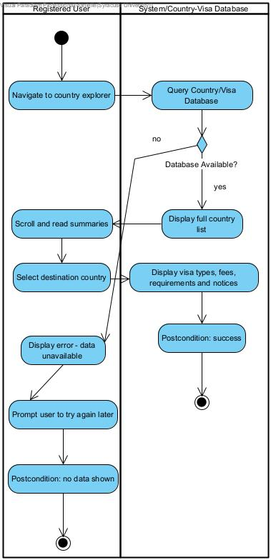
View Countries to Travel to
Further associated features:
Searching by filters
View notices based on the country of citizenship chosen by the user
Notes:
Looking at the activity diagram, there are two swimlanes — Registered User on the left and System on the right.
In the sunny day scenario, the user navigates to the explorer, the system queries the database and displays the country list, the user scrolls and selects a destination, and the system responds with that country's visa types, requirements, fees, and notices. The flow ends at the success postcondition.
In the rainy day scenario, the branch happens at the decision node in the system swimlane. If the database is unavailable, the flow takes the exception path to the left — the system displays an error message, prompts the user to try again later, and the use case ends at the failure postcondition. No partial or stale data is shown without a warning.

Slide 20
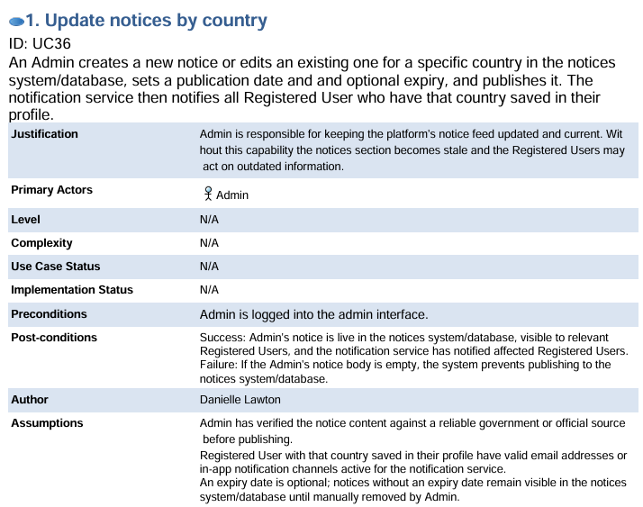
Update notices by country
Notes:
This is the Update Notices by Country Use Case. This is an admin-facing use case that sits on the other side of what users see in country browsing. When a registered user selects a destination and sees current notices for that country, those notices exist because an admin has created and maintained them. The two use cases are directly connected.
The primary actor is the Admin. Also included are the notices system/database and the notification service, the database stores the notices and the notification service pushes alerts out to affected registered users.
The admin must be logged into the admin interface. We also assume the admin has verified the notice content against a reliable official source before publishing, and that affected registered users have active notification channels so the Notification Service can reach them. Expiry dates are optional — notices without one remain in the database until the admin manually removes them.
On success, the notice is live in the Notices Database and all affected registered users have been notified. On failure, the publish is blocked, no incomplete notice is saved, and the admin is prompted to correct the issue.

Slide 21
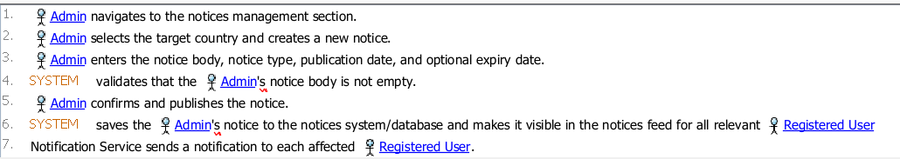
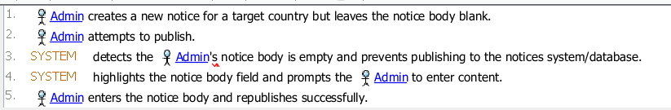
Update notices by country
Sunny Day
Admin successfully posts a new notice for a country.
Rainy Day
Admin attempts to publish a notice with an empty notice body.
Notes:
The admin navigates to the notices management section, selects a target country, creates a new notice, and enters the body, type, publication date, and optional expiry. The admin then confirms and publishes, which triggers the system to validate the notice body before saving.

Slide 22
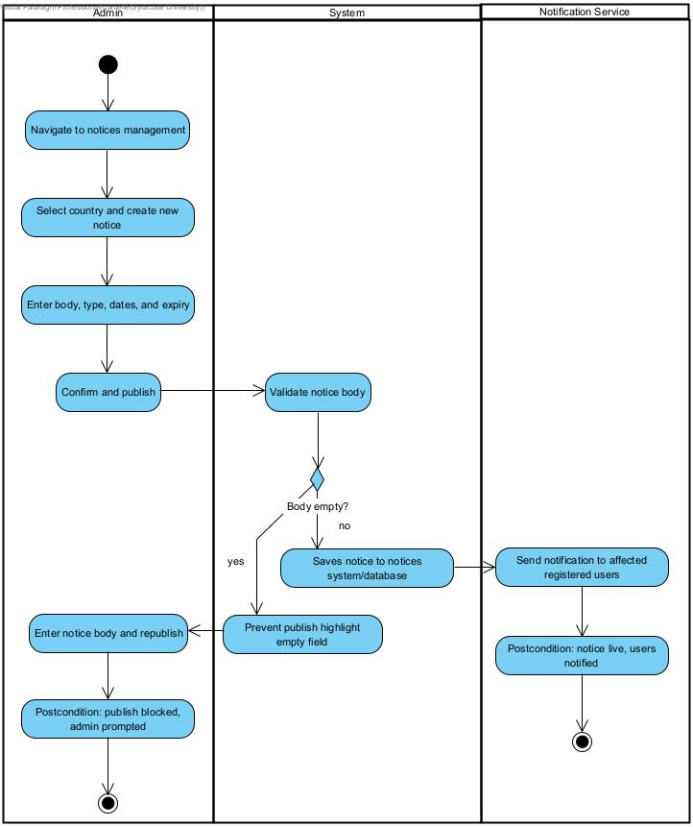
Update notices by country
Notes:
This activity diagrams uses three swimlanes — Admin on the left, System in the middle, and Notification Service on the right.
In the sunny day scenario the admin completes all fields and confirms. The decision node in the system swimlane asks whether the body is valid. Since the body is not empty the answer is yes and the flow continues downward. The system saves the notice to the Notices Database and control crosses right into the Notification Service swimlane, where notifications are sent to all registered users who have that country saved in their profile. The use case ends at the success postcondition.
In the rainy day scenario the admin leaves the notice body empty and attempts to publish. The decision node returns no, and the flow routes right along the outer margin of the diagram, dropping down past all the sunny day content before crossing back into the error handling steps. The system prevents publishing and highlights the empty field. The admin enters the body and republishes. The use case ends at the failure postcondition. This is a recoverable error — the admin can fix it within the same session without starting over.

Slide 23
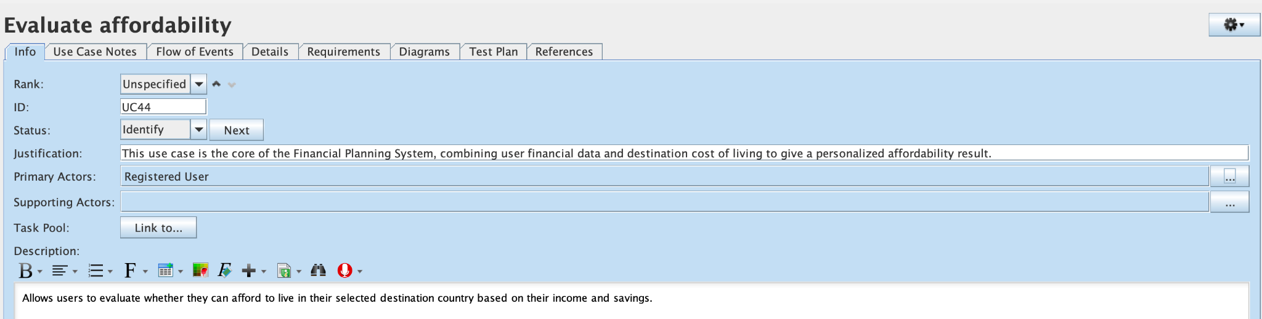
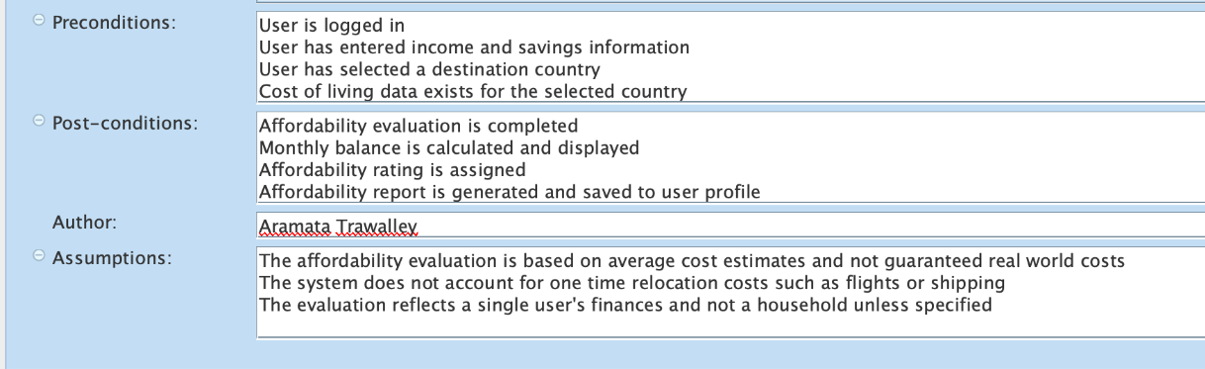
Evaluate Affordability

Slide 24
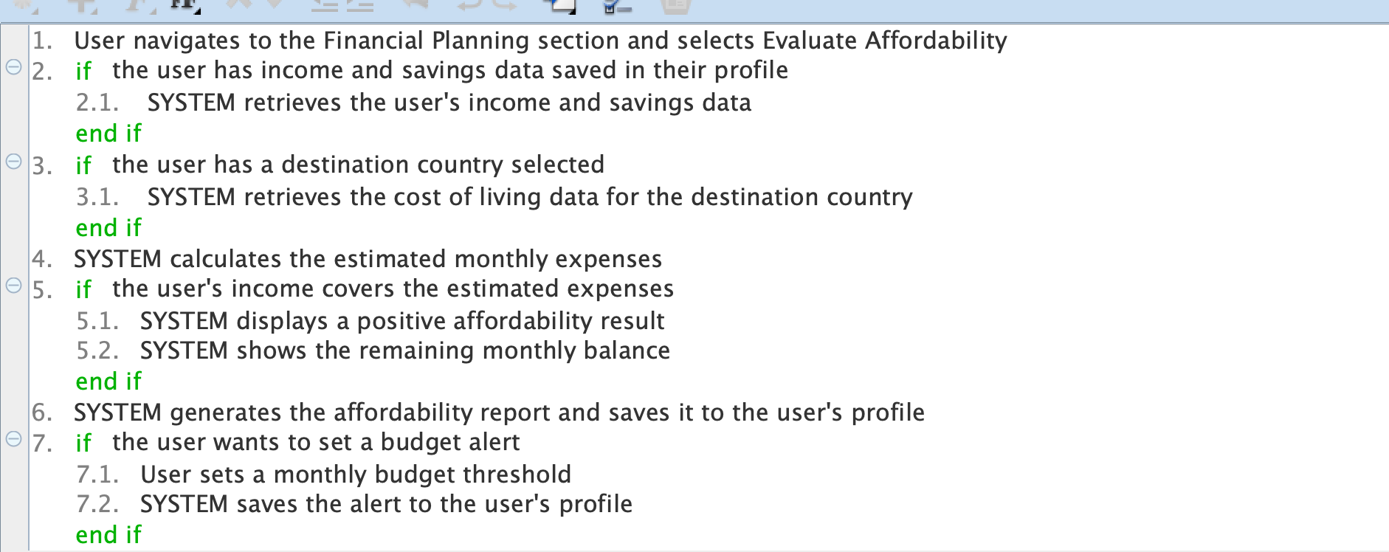
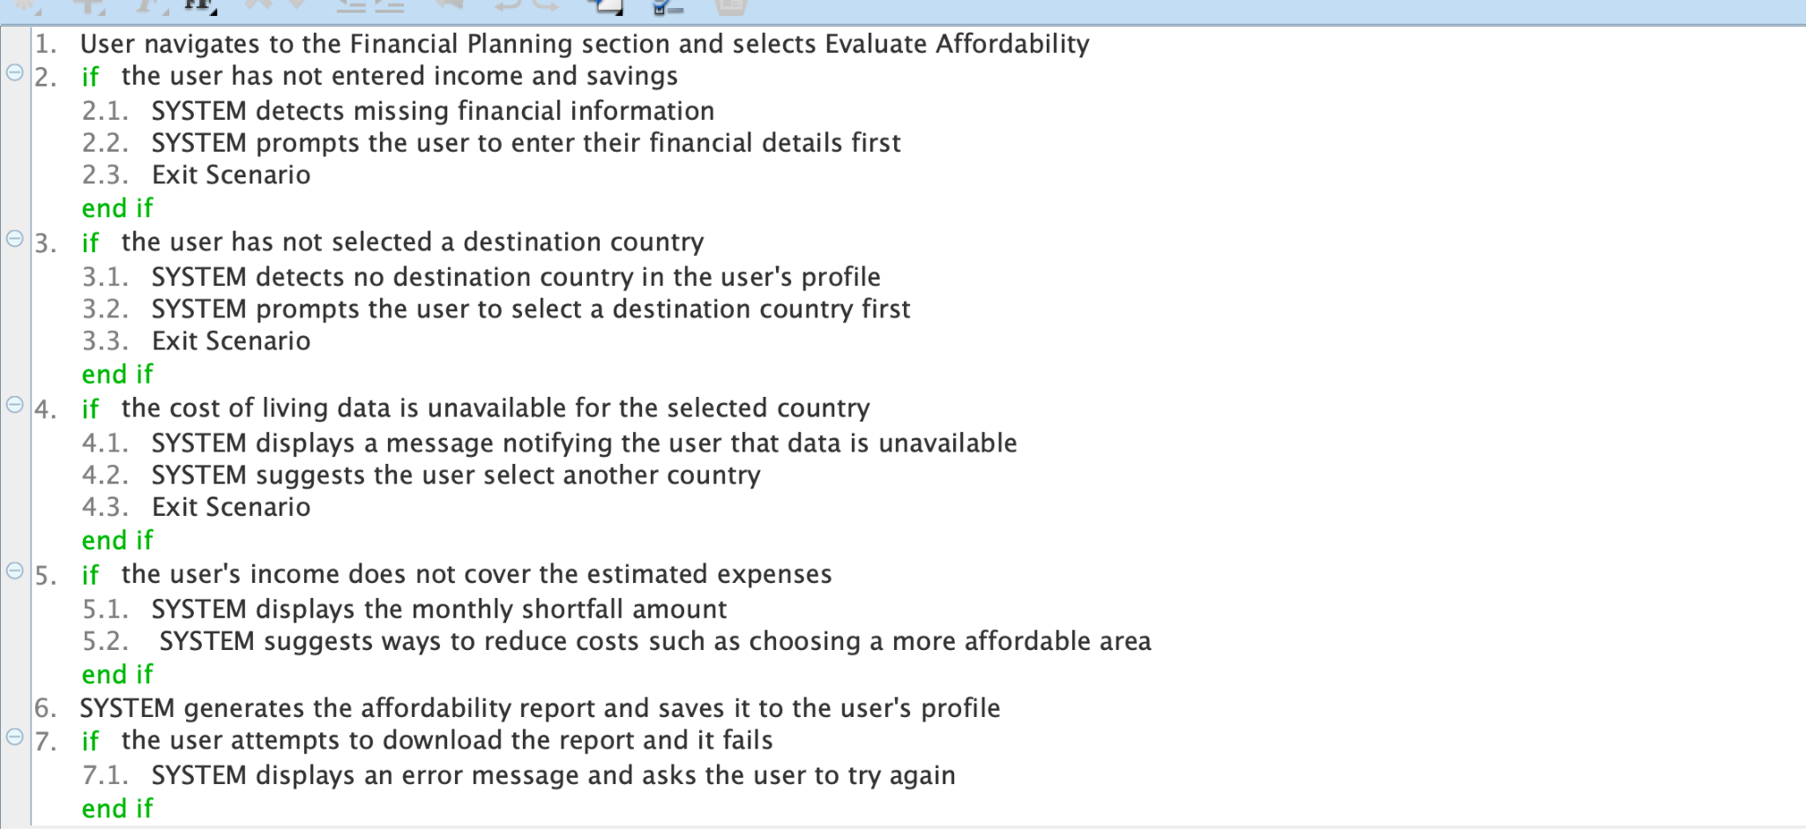
Evaluate Affordability
Sunny Day
Rainy Day

Slide 25
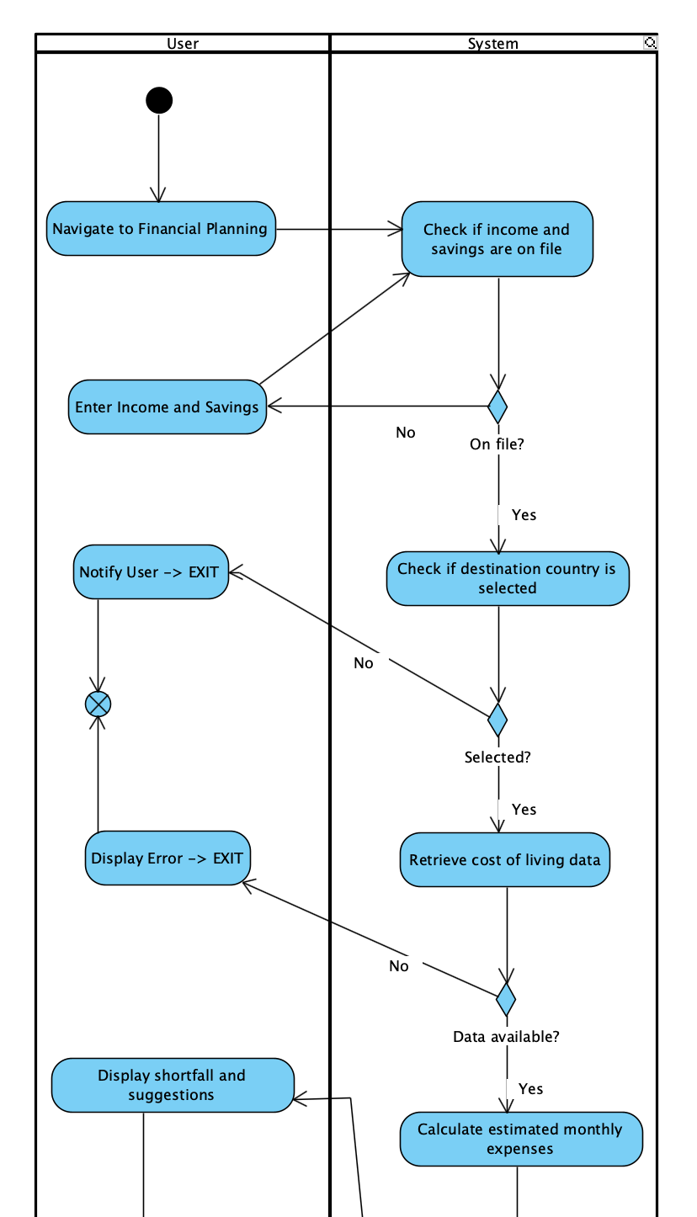
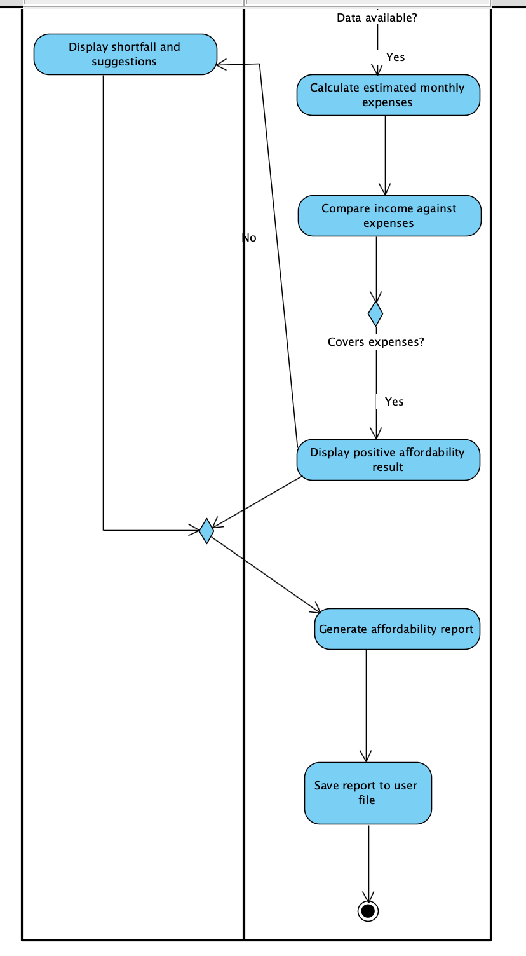
Evaluate Affordability

Slide 26
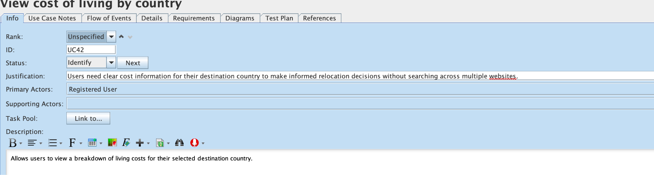
View cost of living by country

Slide 27
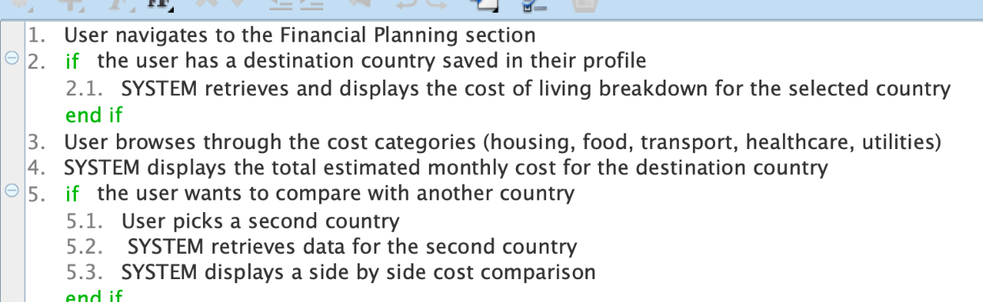
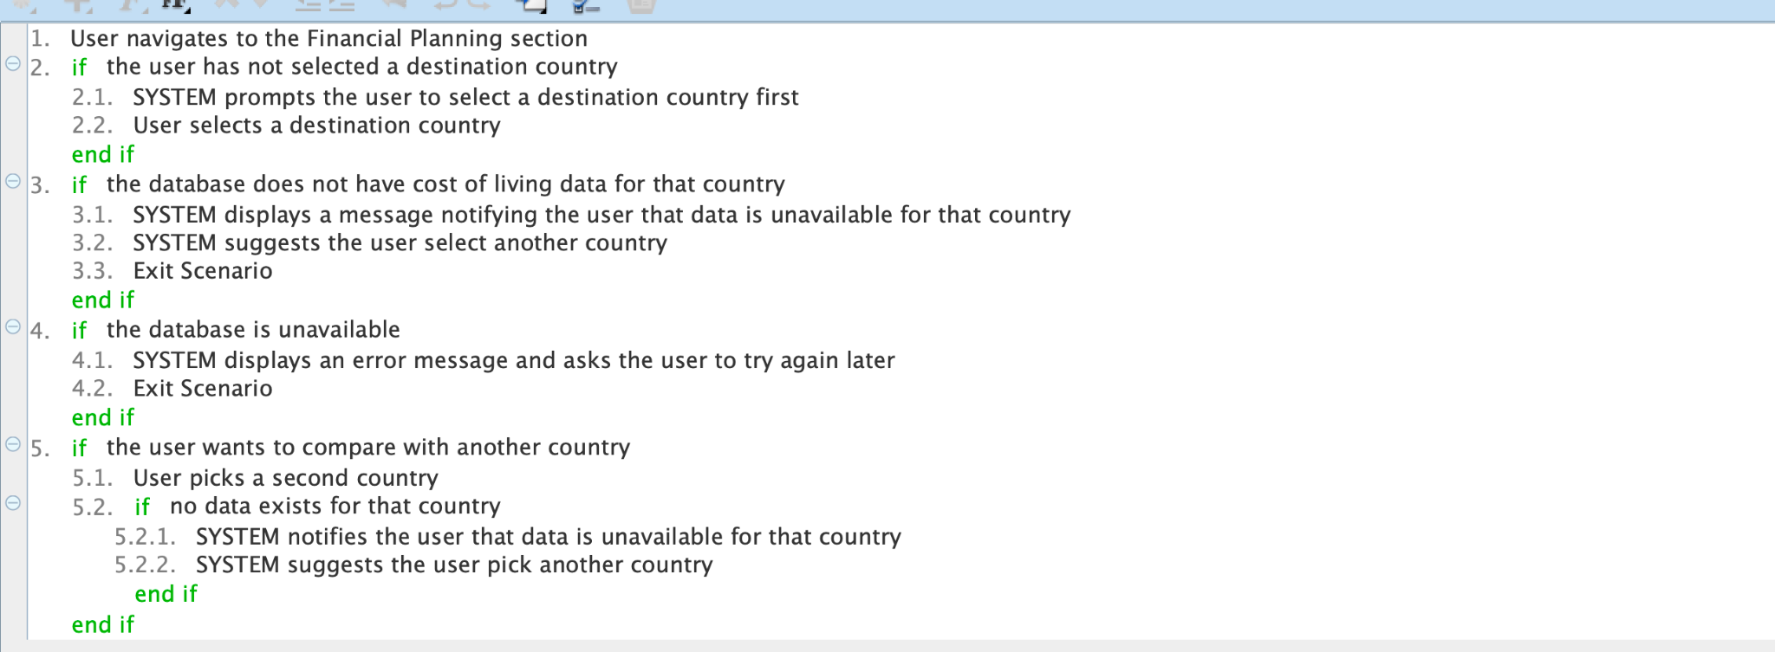
View Cost of Living by country
Sunny Day
Rainy Day

Slide 28
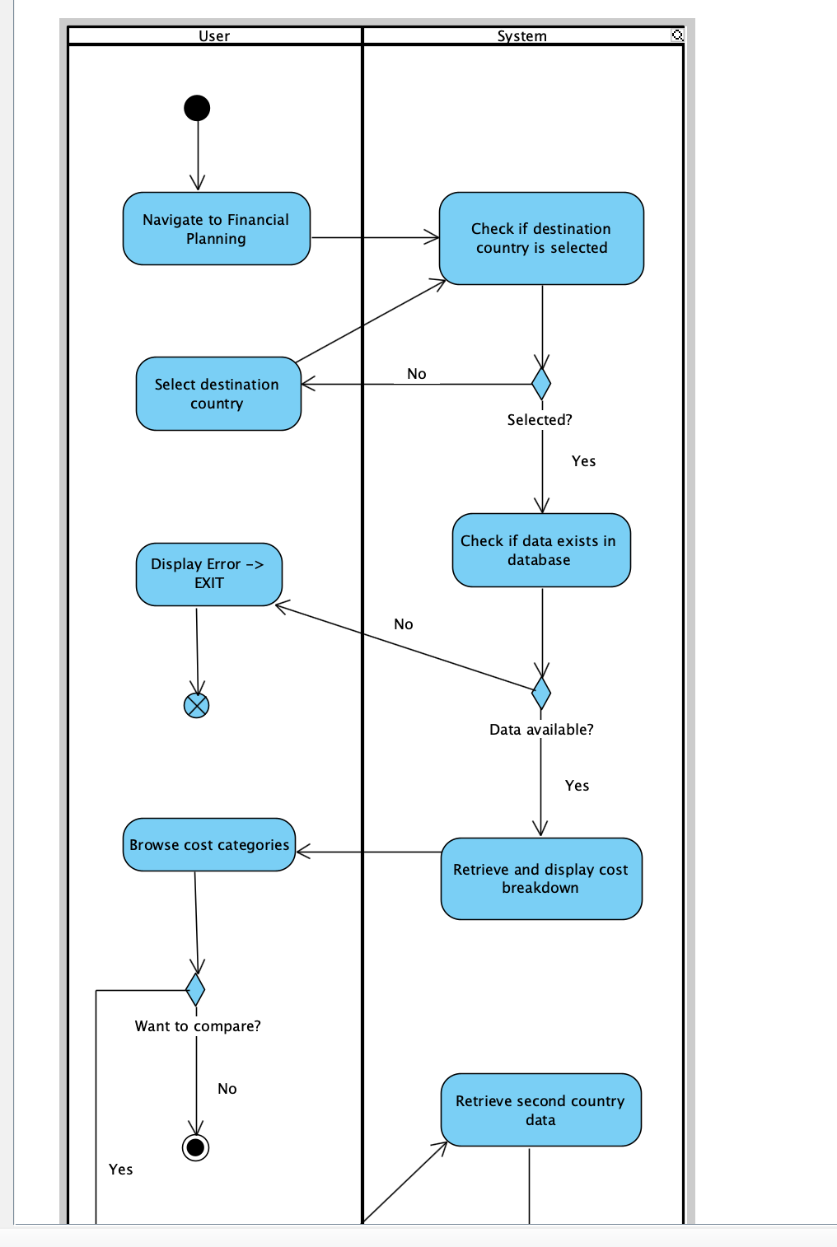
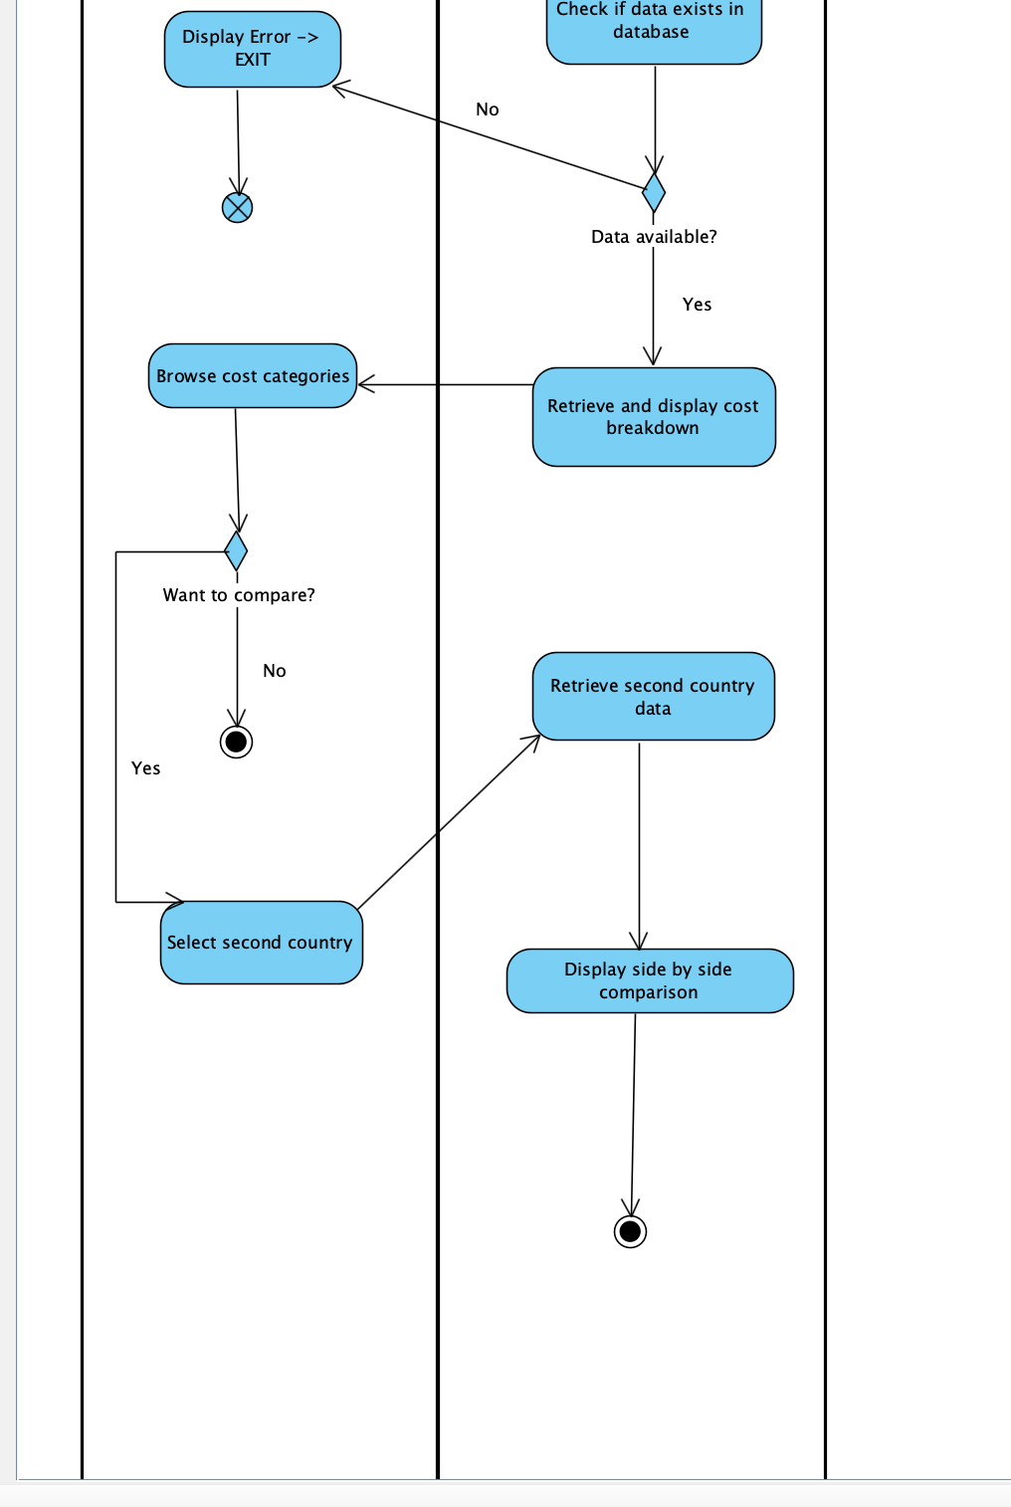
View Cost of Living by Country

Slide 29
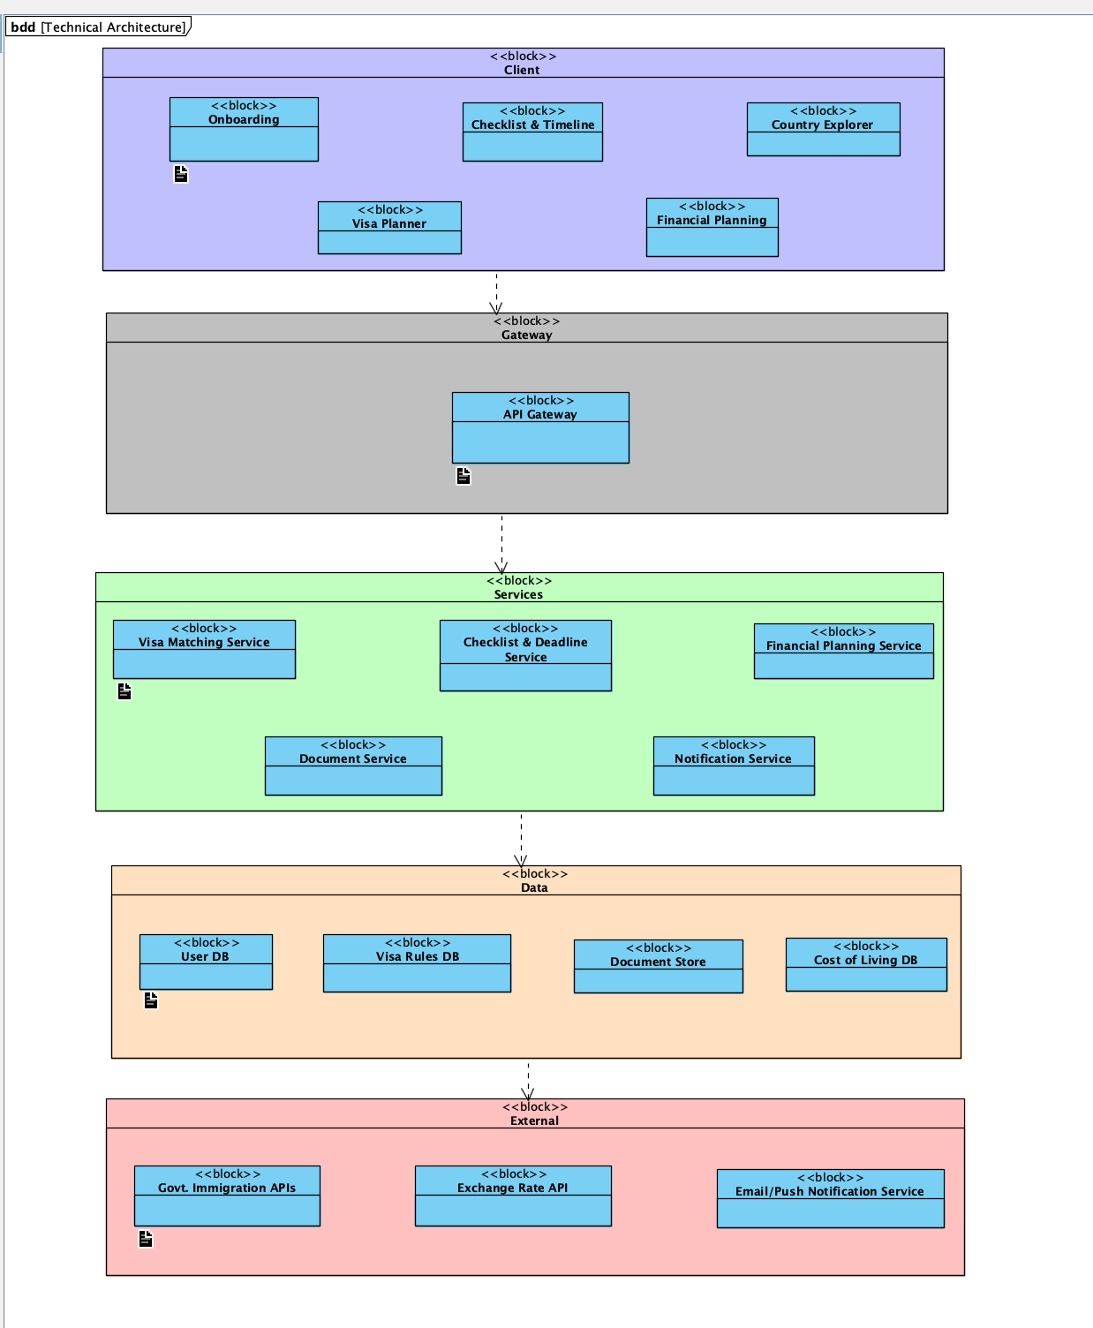
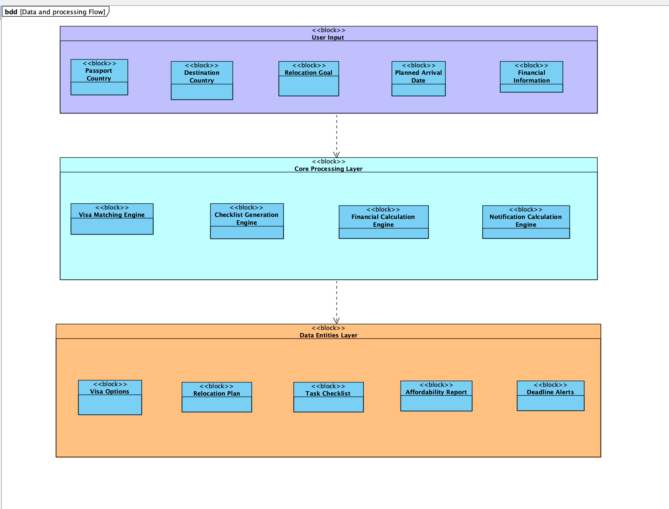
Structure/system architecture diagram

Slide 30
Thank you!

